Slide 1
NAO Night #2

Slide 2
Agenda
Basic Syntax
Loopy programs
Touching game
FTP
Playing sounds

Slide 3

Syntax - Variables
Inferred variable types
Downsides: If the interpreter infers to variables are integers and you divide them, you won’t get a decimal/float

Slide 4

Variables - Casting
Solution:
Cast your variables to specific types
int(value)
float(value)
str(value)

Slide 5
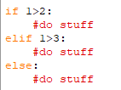
If statements
Have to be good at formatting your code
Be careful when copying code from the
Internet. The tabbing + spacing might not
be correct.
tab

Slide 6

While statements
Almost the exact same as any other
language
No such thing as a do-while.

Slide 7



Range(start, end, increment)
Overload Functions
range(end) # start=0, increment=1
range(start, end) #increment=1

Slide 8





For statements
Python
Very powerful + flexible in Python
Other languages

Slide 9
Python looping programs
Reasons for looping programs:
Interactions with the robot
Monitor the robot’s actions + tasks
Video / Audio from the robot

Slide 10
Define our problem
Touch me game
1) The robot tells the user to touch it in a specific spot
2) The robot waits for touches
3) The robot tells the user if they are correct

Slide 11
Basic Program Structure
Connect to robot
(TextToSpeech)
(ALTouch)
Logic

Slide 12
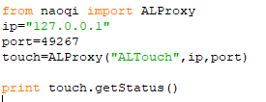
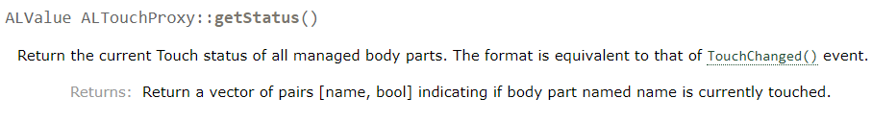
ALTouch - Connect

Slide 13
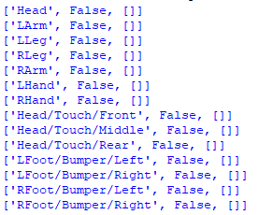
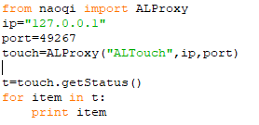
touch.getStatus()

Slide 14
Connect to robot
(TextToSpeech)
(ALTouch)
✓
Logic

Slide 15
ALTouch - Logic
Ask if user can touch body part
Go in while loop
Exit loop when they touch correct spot

Slide 16
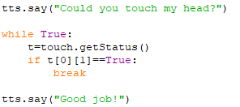
ALTouch - Logic
1) Ask user
2) Go in loop
3) Exit loop when correct

Slide 17

ALTouch - Logic
t=
0
1
2
3
4
5
6
7
8
9
10
11
12
13

Slide 18
FTP
FTP = File Transfer Protocol
Used to transfer files to and from computers
winscp.net

Slide 19
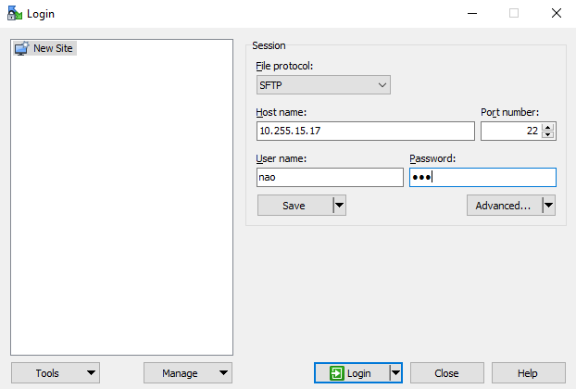
Host name: IP of robot
User name: nao
Password: nao

Slide 20
Download a .WAV file
goo.gl/tuA5ze
goo.gl/LmzXwR
goo.gl/gq2UAU

Slide 21
Uploading a .WAV file

Slide 22
Playing the file

